Slide 1
Weekly Review

Slide 2
Duolingo
Tyler Siegmund – 100 days!
Six people quit

Slide 3
Bonus Submissions
Alex Plitt
Text-based Persona 5 in Python
Macarios Hoover
https://mhoover0413.github.io/
12 Juniors, 9 hours in class, only two projects?
Prepare for the consequences

Slide 4
My Reflection pt1
What is one technique thing you learned in coding teaching this week, and how will you use it in the future?
I already know that establishing a routine and consistent expectations is critical for most students, but I also have to remain flexible and make changes as necessary, because every class/student is unique.
I believe the consistent expectation of code output from the seniors is the way to go. We should be handling project management all year round.
But expecting everything to be planned, built, merged, and tested in a weekly cycle is too much for one teacher to manage. This is how so many bugs got into the Formbar.
Moving forward, we will try alternating weeks for merging/testing/planning and coding.

Slide 5
My Reflection pt2
What was a challenge to your time management this week, and what can you do to avoid it in the future?
I can usually start the week strong, staying after work or putting in more effort during planning period to get caught up on work.
However, if I keep that pace I will burnout by Wednesday or Thursday, allowing things to pile up for next week.
I should be designating a specific recurring task each day immediately after school.
Wednesday is CyberPatriot day. I should get into that habit of doing my college work at 3pm every Wednesday, even if there is no CyberPatriot.

Slide 6
My Reflection pt3
What opportunities DID you take advantage of this week?
I stayed late Tuesday last week to help with Unified Bocce Ball. Ms. Hicks and I have been making friends with Ms. Cayce, who mentioned she was overwhelmed with all of her afterschool activities and didn’t have anyone to help her on Tuesday. I decided if I want to make friends, I have to go to where they are. It turns out they had enough people, and I didn’t even get to talk to Ms. Cayce while I was there. I did, however, get to control the scoreboard in the gym, and many of the school staff and administration saw me there. Now that other people in the school know that I am willing to participate, it may open doors for me in the future.
I would have stayed home and played Warhammer for the 700th day in a row.

Slide 7
This week / Loose Ends
Continuing CIW as normal
Ok, seriously the Exam will be graded this week.
Chapters 1 - 10
Many of you mentioned you spent a lot of time studying, but then we didn’t even take the test
I cancelled because I wanted to make sure everyone could get their big assignment done for the week. We were cutting it close.
You need to do CIW at home
Juniors, you’re approaching Seniorhood.
Your workload will be increasing
TOURS! Ask for passes if you want to do tours this week.
Stop putting the hole punch on the wrong shelf
Put things back where you found them.

Slide 8
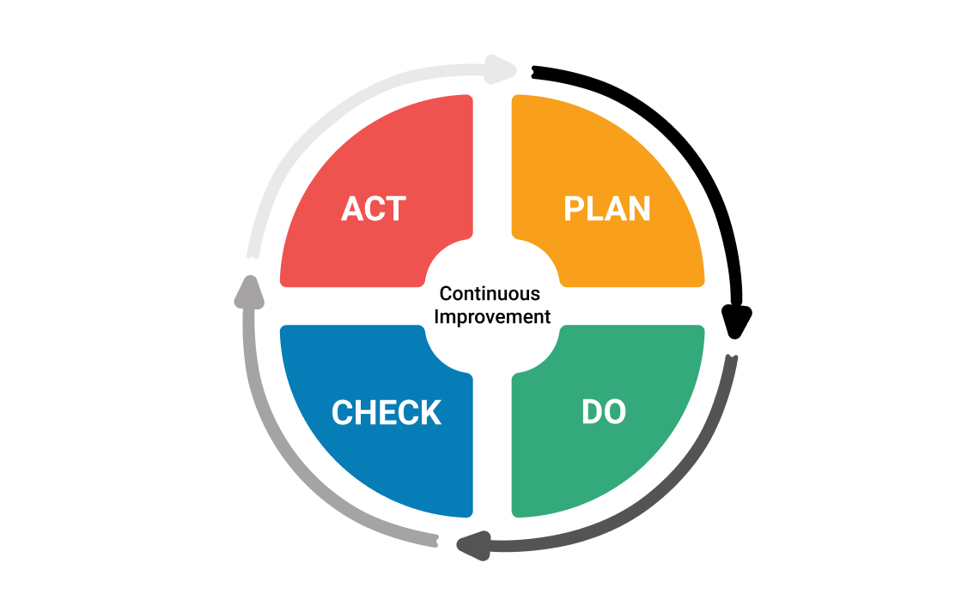
Continuous Improvement

